Slide 1
Microsoft Azure Introduction

Slide 2
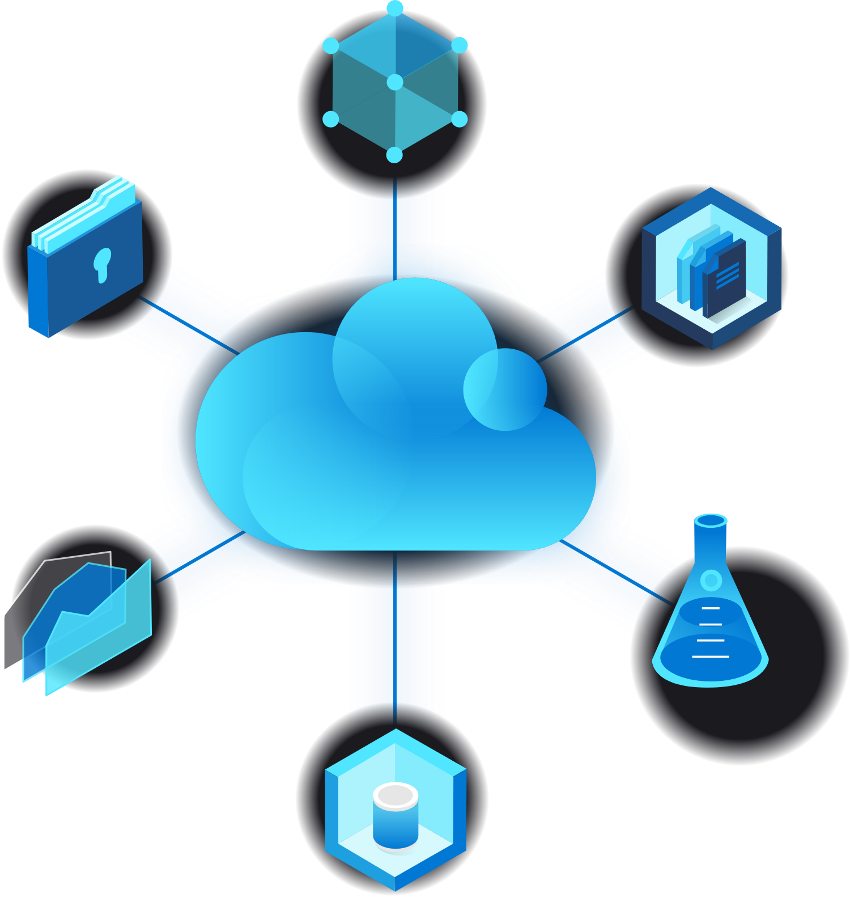
What is Cloud Computing?
Overview:
Cloud computing is the delivery of computing services ranging from Storage, Analytics, Networking, and much more over the internet (i.e. cloud).
Resource Link:
What Is Cloud Computing? A Beginner’s Guide | Microsoft Azure

Slide 3







Cost | Speed | Global Scale | Productivity
Cloud computing eliminates the capital expense of buying hardware and software and setting up and running on-site datacenters—the racks of servers, the round-the-clock electricity for power and cooling, and the IT experts for managing the infrastructure. It adds up fast. | Most cloud computing services are provided self service and on demand, so even vast amounts of computing resources can be provisioned in minutes, typically with just a few mouse clicks, giving businesses a lot of flexibility and taking the pressure off capacity planning. | The benefits of cloud computing services include the ability to scale elastically. In cloud speak, that means delivering the right amount of IT resources—for example, more or less computing power, storage, bandwidth—right when they’re needed, and from the right geographic location. | On-site datacenters typically require a lot of “racking and stacking”—hardware setup, software patching, and other time-consuming IT management chores. Cloud computing removes the need for many of these tasks, so IT teams can spend time on achieving more important business goals.
Performance | Reliability | Security
The biggest cloud computing services run on a worldwide network of secure datacenters, which are regularly upgraded to the latest generation of fast and efficient computing hardware. This offers several benefits over a single corporate datacenter, including reduced network latency for applications and greater economies of scale. | Cloud computing makes data backup, disaster recovery, and business continuity easier and less expensive because data can be mirrored at multiple redundant sites on the cloud provider’s network. | Many cloud providers offer a broad set of policies, technologies, and controls that strengthen your security posture overall, helping protect your data, apps, and infrastructure from potential threats.
Resource Link:
What Is Cloud Computing? A Beginner’s Guide | Microsoft Azure

Slide 4
What is a Cloud Provider?
Salesforce
Overview:
The cloud provider is responsible for the physical hardware required to execute your work, and for keeping it up-to-date. The computing services offered tend to vary by cloud provider. However, typically they include:
Compute power - such as Linux servers or web applications used for computation and processing tasks
Storage - such as files and databases
Networking - such as secure connections between the cloud provider and your company
Analytics - such as visualizing telemetry and performance data
Amazon Web Services
Google Cloud
Microsoft Azure
Resource Link:
What Is Cloud Computing? A Beginner’s Guide | Microsoft Azure

Slide 5




What is Azure?
Microsoft Azure is an ever-expanding set of cloud services to help your organization meet your business challenges. It’s the freedom to build, manage, and deploy applications on a massive, global network using your favorite tools and frameworks.
Future-Ready
Continuous innovation from Microsoft supports your development today, and your product visions for tomorrow.
Build on Your Terms
With a commitment to open source, and support for all languages and frameworks, build how you want, and deploy where you want to.
Operate Hybrid Seamlessly
On-premises, in the cloud, and at the edge—we’ll meet you where you are. Integrate and manage your environments with services designed for hybrid cloud.
Trust Your Cloud
Get security from the ground up, backed by a team of experts, and proactive compliance trusted by enterprises, governments, and startups.
Resource Link:
What is Azure—Microsoft Cloud Services | Microsoft Azure

Slide 6
Microsoft Azure Account Services

Slide 7

Azure Subscriptions
Free Subscription | Pay-As-You-Go | Enterprise Agreements | Student
An Azure free subscription includes a $200 credit to spend on any service for the first 30 days, free access to the most popular Azure products for 12 months, and access to more than 25 products that are always free. This is an excellent way for new users to get started. To set up a free subscription, you need a phone number, a credit card, and a Microsoft account. | A Pay-As-You-Go (PAYG) subscription charges you monthly for the services you used in that billing period. This subscription type is appropriate for a wide range of users, from individuals to small businesses, and many large organizations as well. | An Enterprise Agreement provides flexibility to buy cloud services and software licenses under one agreement, with discounts for new licenses and Software Assurance. It’s targeted at enterprise-scale organizations. | An Azure for Students subscription includes $100 in Azure credits to be used within the first 12months plus select free services without requiring a credit card at sign-up. You must verify your student status through your organizational email address.
Resource Link:
Subscriptions | Microsoft Azure

Slide 8






Creating an Azure Account
Step 1: Visit URL
In a web browser, go to Microsoft Azure.
Step 2: Sign In
Scroll down through the page to learn more about the benefits and free services available. Select Start free. Sign in with your Microsoft or GitHub account or create a free Microsoft account.
Step 3: Provide Info
On the About you page, select your correct country or region. Enter your first and last name, email address, and phone number. Depending on your country, you might see additional fields, such as a VAT number. Select Next to continue. On the Identity verification by phone screen, select your country code, and type the number of a telephone to which you have immediate access.
Step 4: Verify Identity
You have the option of text or callback to obtain a verification code. Select the relevant button, type the code in the Verification code box and select Verify code.
Step 5: Agree to Terms
If the verification code is correct, you're asked to enter details of a valid credit card. Enter the card information and select Next. The last step is to review the agreement and privacy statement then select Sign up.
Step 5: Go to Azure Portal
You have successfully set up a free account and should be on the Azure portal home page.

Slide 9

What are Azure Resource Groups?
Overview:
A resource group is a container that holds related resources for an Azure solution. The resource group can include all the resources for the solution, or only those resources that you want to manage as a group. You decide how you want to allocate resources to resource groups based on what makes the most sense for your organization. Generally, add resources that share the same lifecycle to the same resource group so you can easily deploy, update, and delete them as a group.
The resource group stores metadata about the resources. Therefore, when you specify a location for the resource group, you are specifying where that metadata is stored. For compliance reasons, you may need to ensure that your data is stored in a particular region.
Resource Link:
Azure Resource Groups | Microsoft Azure

Slide 10
Azure Accounts & Subscriptions
Azure Account
Subscription 1
Subscription 2
Subscription 3
Resource Group 1
Resource Group 2
Resource Group 1
Resource Link:
Azure Resource Groups | Microsoft Azure

Slide 11
Microsoft Azure Authentication & Authorization

Slide 12

Accessing your Azure Resources
Overview:
Most cloud applications deployed to Azure need to access other Azure resources such as storage, databases, stored secrets, and so on. To access those resources, the application must be both authenticated and authorized:
Authentication verifies the app's identity with Azure Active Directory.
Authorization determines which operations the authenticated app can perform on any given resource. The authorized operations are defined by the roles assigned to the app identity for that resource. In a few cases, such as Azure Key Vault, authorization is also determined by additional access policies that are assigned to the app identity.
Resource Link:
Azure Authentication | Microsoft Azure

Slide 13
Why is this Important?
Overview:
A reoccurring theme you’ll see inside of Azure has to do with customizability and granularity. Microsoft wants you to be able to control what resources someone can control and how much of that resource they can control. For example, I want you to be able to access my database, but I don’t want you to be able to have the authority to write new data to it.
For me this is great, I can give you access to my database, but I can control what you can do with it.

Slide 14

Azure Active Directory
Overview:
Instead of creating apps that each maintain their own username and password information, which incurs a high administrative burden when you need to add or remove users across multiple apps, apps can delegate that responsibility to a centralized identity provider.
Azure Active Directory (Azure AD) is a centralized identity provider in the cloud. Delegating authentication and authorization to it enables scenarios such as Conditional Access policies that require a user to be in a specific location, the use of multi-factor authentication (sometimes referred to as two-factor authentication or 2FA), as well as enabling a user to sign in once and then be automatically signed in to all of the web apps that share the same centralized directory. This capability is referred to as Single Sign On (SSO).

Slide 15
Why is this Important?
Overview:
We can see at this point, that security is a very important pillar inside the world of Azure. However, security can be a complex issue depending on what you’re trying to do. Microsoft Azure tries to simplify this process using the Azure Directory which can allow you to handle multiple different scenarios in terms of authentication & authorization.
Now that we know why the Azure Active Directory is so important, it naturally leads to another question. How do we use it?
Well, it involves the idea of registering your App with the Active Directory. When we register it with the AD, we can define our authentication protocol. However, this is where things can get a little bit confusing because when we register our app a few different things will happen.

Slide 16

Registering Our Applications
Overview:
When we register our Application with the Azure AD, two different objects are created for us.
Application Objects:
Although there are exceptions, application objects can be considered the definition of an application.
Service Principals:
Service principals generally reference an application object, and one application object can be referenced by multiple service principals across directories.
Okay, so what are these two objects and how are they related? Well in simple terms one defines a template, and one defines how we can access our application. However, let’s explore these two objects in more detail.

Slide 17
Application Objects:
Overview:
An Azure AD application is defined by its one and only application object, which resides in the Azure AD tenant where the application was registered (known as the application's "home" tenant). The application object describes three aspects of an application:
How the service can issue tokens in order to access the application.
Resources that the application might need to access
The actions that the application can take.
An application object is used as a template or blueprint to create one or more service principal objects.

Slide 18

Service Principals:
Overview:
To access resources that are secured by an Azure AD tenant, the entity that requires access must be represented by a security principal. This requirement is true for both users (user principal) and applications (service principal). The security principal defines:
The access policy.
The permissions for the user/application in the Azure AD tenant.
This enables core features such as authentication of the user/application during sign-in, and authorization during resource access. A service principal is created in every tenant where the application is used.

Slide 19
Alex’s Notes:
Okay so this topic can be very confusing if it’s your first time seeing it, so I want to take some time to explain it in more layman's terms.
The application object is the global representation of your application for use across all tenants, and the service principal is the local representation for use in a specific tenant. Let me put it a different way, I create a very simple application that can do 4 things:
Create new records in a database.
Update existing records in a database.
Delete existing records in a database.
Query existing records in a database.
We do a lot of work and create our simple application and decide to register it with the Azure Active Directory because we want to make sure we know who accesses this application (Authentication) and if they can access all the functionality of our application (Authorization). When we register the application with Active Directory, we create two things:
An Application Object.
A Service Principal Object.
The Application Object, serves as a template it says what the application is and what it can do. At some point we will want to access our Application, and when we want to, we will use our Service Principal Object. The Service Principal Object will define what we can access inside of our application. Take a second and think about that! I might want to give Joe the ability to query records, but not delete records. In that case I can create a Service Principal that gives Joe that specific access. On the other hand, I have Alex who I want to give full access to, in that case I can create another Service Principal that references the same application but has more access to it.

Slide 20
Microsoft Azure Creating a Service Principal

Slide 21
Introduction
At this point we should have a decent understanding of the following: The role the Azure Active Directory plays in terms of authentication. How we use the Azure Active Directory in terms of accessing our applications. Why We register our applications in the Directory. What happens when we register an App in the Directory. What is an Application Object. What is a Service Principal Object. With those fundamental concepts, let’s walk through the process of creating a Service Principal, , setting up our environment so we can use our Service Principal, and using our Service Principal to access a resource. While there are different places you can create a Service Principal, you’ll find that a lot of examples will use the Azure Command Line Interface (CLI). Because this is such a common example, you’ll see we will be focusing on this method in our series.

Slide 22

Role-Based Access Control (RBAC)
Overview:
Access management for cloud resources is a critical function for any organization that is using the cloud. Azure role-based access control (Azure RBAC) helps you manage who has access to Azure resources, what they can do with those resources, and what areas they have access to. Azure RBAC is an authorization system built on Azure Resource Manager that provides fine-grained access management of Azure resources. It allows us to define the following points:
Who has access?
What type of access?
How much access?
Resource Link:
Azure RBAC | Microsoft Azure

Slide 23
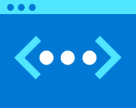
Download the Azure CLI
Overview:
We will be using the Azure CLI to create our RBAC tenant, so you’ll need to download it before you proceed to the next part.
Azure CLI Download Page

Slide 24
Install the Required Python Packages
Overview:
Other Resources:
We will be using the Azure CLI to create our RBAC tenant, so you’ll need to download it before you proceed to the next part.
msrest==0.6.18
msrestazure==0.6.4
azure-core==1.7.0
azure-common==1.1.25
azure-cosmos==4.0.0b6
azure-identity==1.4.0
Name | Link
Python Azure SDKs Library | Python SDK Libraries
Azure for Python Developers | Azure For Python Developers
Azure Python SDK GitHub Repo | GitHub Azure SDK Repo

Slide 25
Microsoft Azure Key Vault

Slide 26

What are Key Vaults?
Overview:
Azure Key Vault is a tool for securely storing and accessing secrets. A secret is anything that you want to tightly control access to, such as API keys, passwords, or certificates. A vault is a logical group of secrets.
Resource Link:
Key Vault | Microsoft Azure

Slide 27
Microsoft Azure Data Services

Slide 28

What is Azure SQL?
Overview:
The family of SQL cloud databases providing flexible options for application migration, modernization, and development. With Azure SQL you get a consistent, unified experience across your entire SQL portfolio and a full range of deployment options from edge to cloud.
Resource Link:
Azure SQL | Microsoft Azure

Slide 29


SQL Services
SQL Server on Azure VM | Azure SQL Managed Instance | Azure SQL Database
Migrate your SQL workloads to Azure with ease while maintaining complete SQL Server compatibility and operating system-level access. | Modernize your existing SQL Server applications at scale with an intelligent, fully managed service. | Support modern cloud applications on an intelligent, fully managed service that includes serverless compute.
Resource Link:
Azure SQL | Microsoft Azure

Slide 30

What is Azure NoSQL?
Overview:
NoSQL databases are interchangeably referred to as “nonrelational,” “NoSQL DBs,” or “non-SQL” to highlight the fact that they can handle huge volumes of rapidly changing, unstructured data in different ways than a relational (SQL) database with rows and tables. NoSQL technologies have been around since the 1960s, under various names, but are enjoying a surge in popularity as the data landscape shifts and developers need to adapt to handle the sheer volume and vast array of data generated from the cloud, mobile, social media, and big data.
Resource Link:
NoSQL Databases | Microsoft Azure

Slide 31



Types of NoSQL Databases
Key-Value | Document | Columnar | Graph
Key-value stores pair keys and values using a hash table. Key-value types are best when a key is known and the associated value for the key is unknown. | Document databases extend the concept of the key-value database by organizing entire documents into groups called collections. They support nested key-value pairs and allow queries on any attribute within a document. | Columnar, wide-column, or column-family databases efficiently store data and query across rows of sparse data and are advantageous when querying across specific columns in the database. | Graph databases use a model based on nodes and edges to represent interconnected data—such as relationships between people in a social network—and offer simplified storage and navigation through complex relationships.
Resource Link:
NoSQL Databases | Microsoft Azure

Slide 32

What is Azure Data Factory?
Overview:
Microsoft Azure Data Factory is a cloud-based data integration service that allows you to create data-driven workflows to orchestrate and automate the extraction, movement and transformation of data. The Azure Data Factory helps simplify and automate the ETL (Extract Transform & Load) process that many companies depend on to do their different types of analysis. One major benefit of the Azure Data Factory is that it has over 90+ different data connectors that can help you integrate data from a wide variety of sources at no additional cost to the user.
Resource Link:
Data Factory - Data Integration Service | Microsoft Azure

Slide 33

Azure Data Factory Components
Pipelines | Activities | Datasets | Linked Services
A data factory can have one or more pipelines. A pipeline is just a container for activities. | A pipeline can have one or more activities. Activities are definitions of what actions to perform on your data, e.g. using the copy activity to move data from one data store to another data store. Activities can also be configured to run conditionally, such as on failure or on success, etc. | Activities take zero or more datasets as inputs and one or more datasets as outputs. Datasets are representative structures of data within datastores. | You can think of these as being like connection strings, they define the connection needed to connect to external resources outside of Azure Data Factory.
Resource Link:
Data Factory - Data Integration Service | Microsoft Azure

